Slide 2


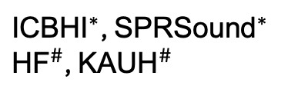
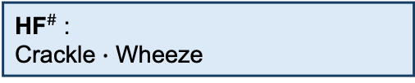

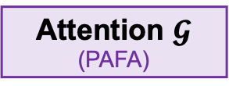
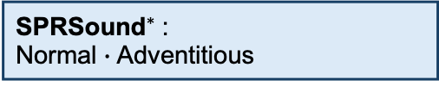
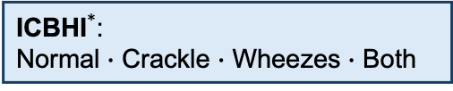

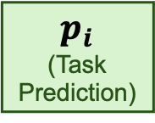

Linear Heads
Task-Specific Outputs
Respiratory Audio
A: Abnormal
${\text{ICBHI}}^{*}$:
Normal $∙$ Crackle $∙$ Wheezes $∙$ Both
BEATs
Encoder
(Pretrained)
$$H_{i}$$
Mean Pooling
(Linear)
$$N×D$$
$$p_{i}$$
(Task Prediction)
C: Crackle
${\text{SPRSound}}^{∗}$:
Normal $∙$ Adventitious
${\text{ICBHI}}^{∗}$, ${\text{SPRSound}}^{∗}$
${\text{HF}}^{\#}$, ${\text{KAUH}}^{\#}$
Attention $𝓖$
(PAFA)
W: Wheeze
${\text{HF}}^{\#}$:
Crackle $∙$ Wheeze
$$1×D$$
$$Z_{i}$$
*: Training + Inference
#: Inference Only
$ℒ = λ_{p}ℒ_{PCSL}$ + $λ_{𝒢}ℒ_{GPAL}$ + $ℒ_{CLS}$ + $λ_{HF}ℒ_{HF}$
${\text{KAUH}}^{\#}$:
Normal $∙$ Abnormal
High Frequency
Loss (Optional)
Pretraining (Contrastive)
Attention Regulation
Classification

